Slide 1
ASSAULT IN DIVISION 51
MILESTONE 3 - GROUP VIII Audience: Chair- Toronto Police Service Board

Slide 2
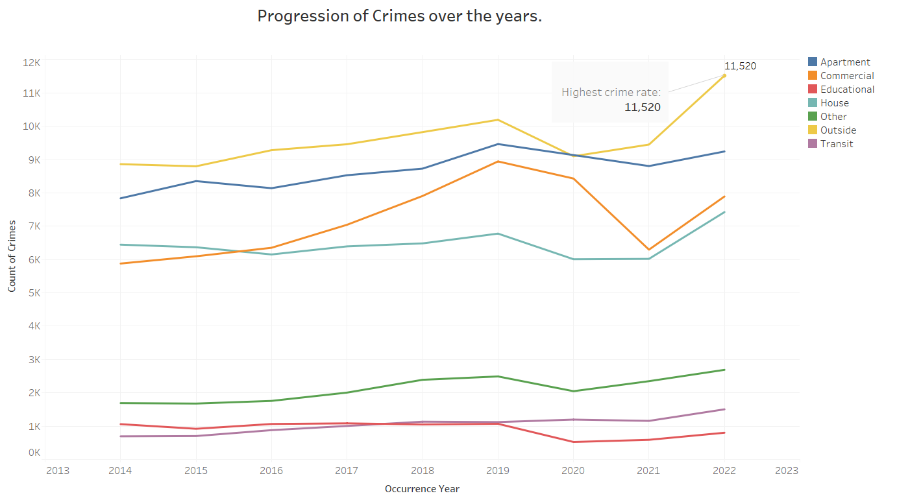

Slide 3
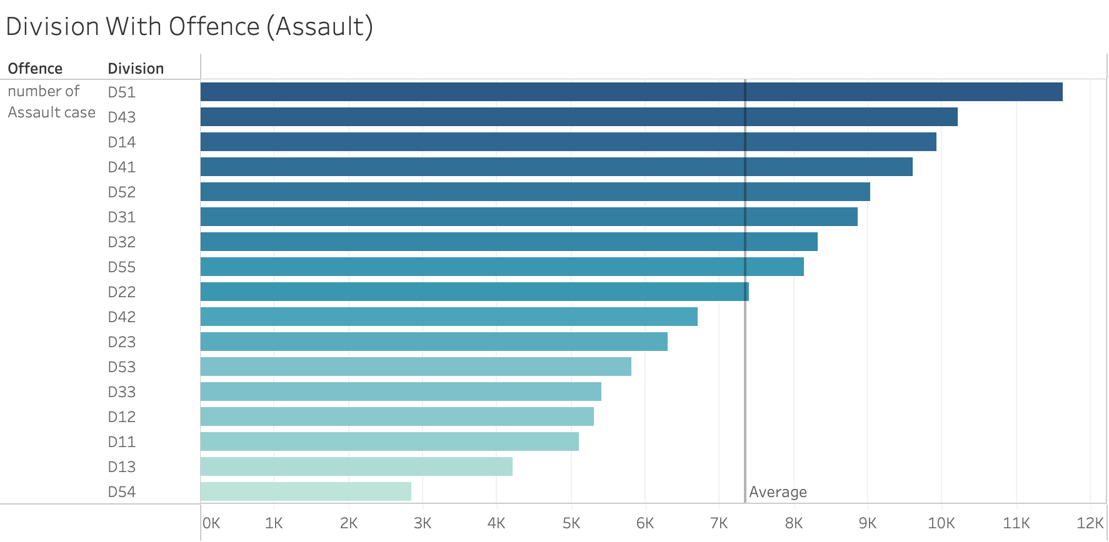

Slide 4
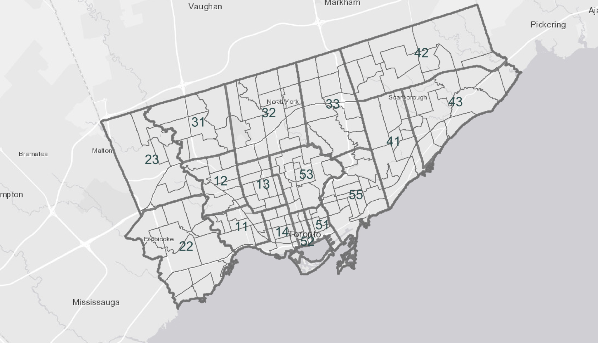

Slide 5
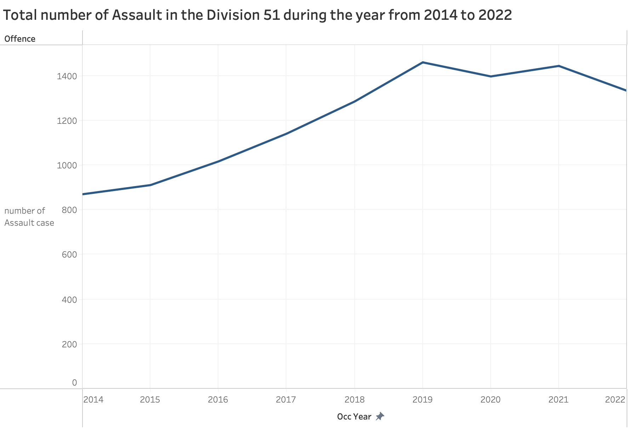

Slide 6
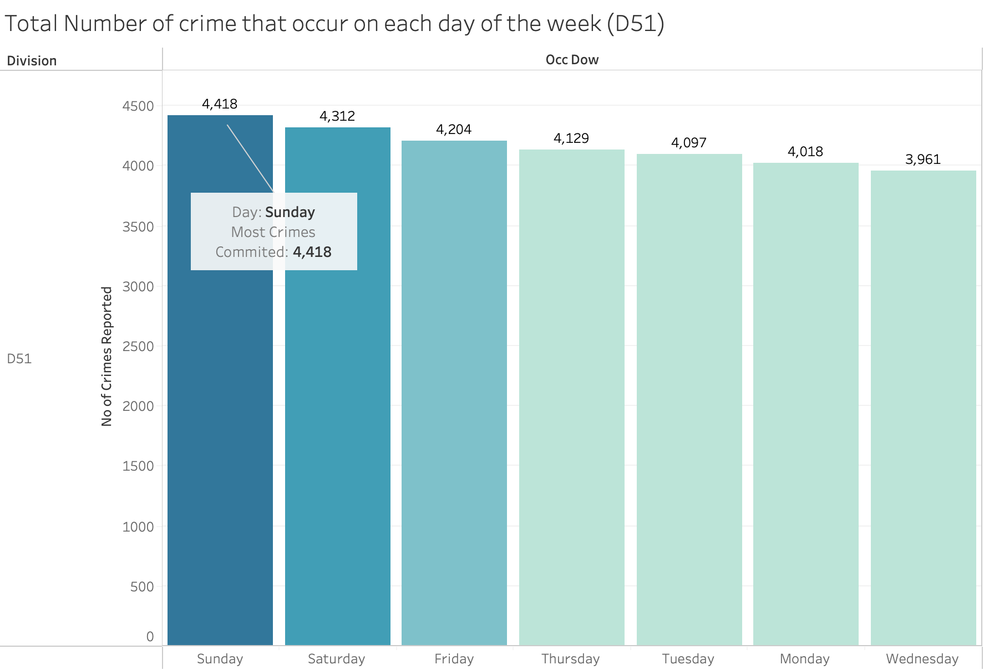

Slide 7
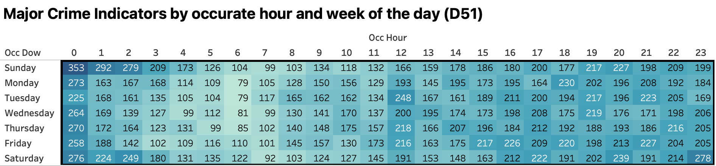
Most Crime happened on Sunday
Mostly happened during 4pm to 12am
Highest Crime happened on Sunday 12am

Slide 8
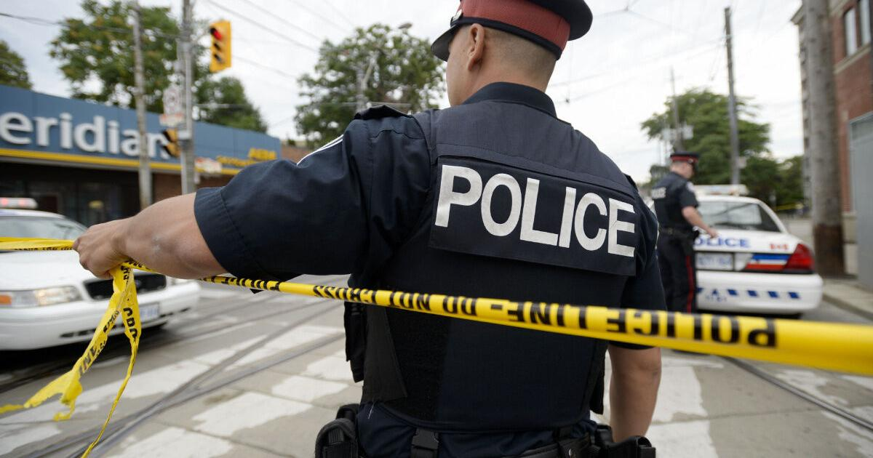
Analysis

Slide 9
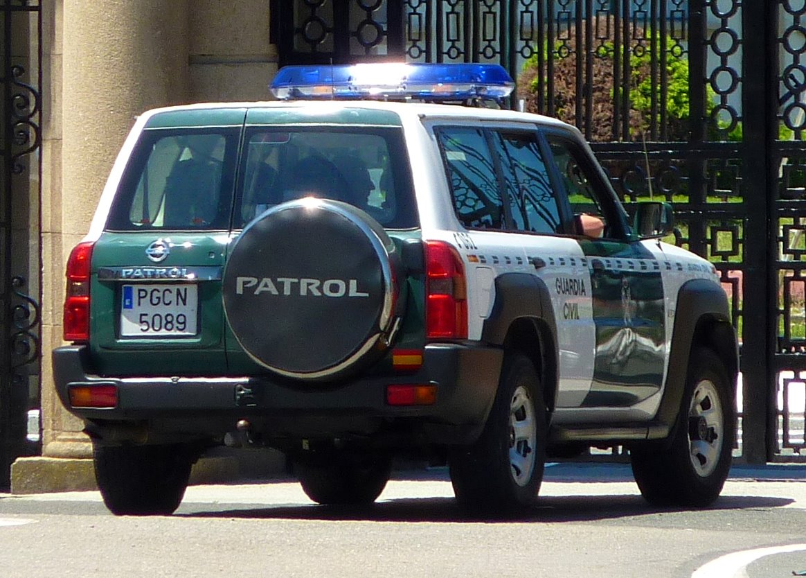
Recommendation
Increase in Patrol on Weekend especially Sunday Midnight.
Allocate resources of D54 that has low crime rate to D51 which evidently has high crime rate.

Slide 10

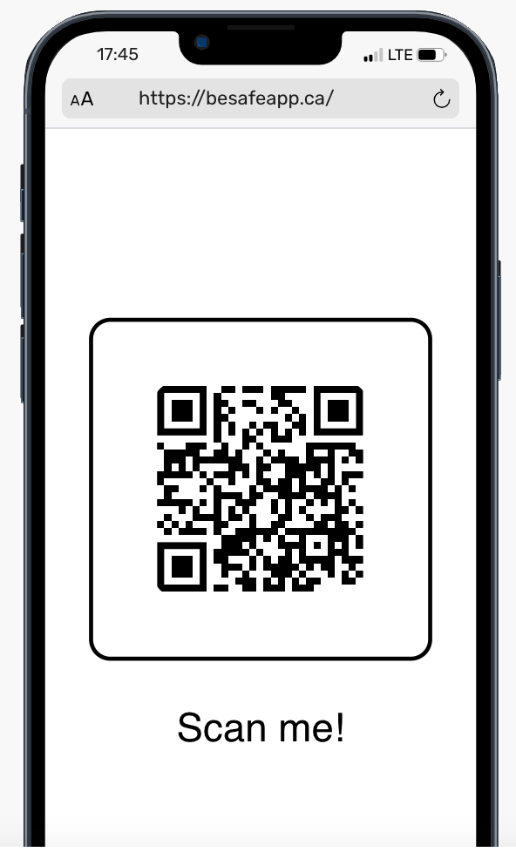
The Be Safe app is to support user safety and well-being. It provides essential resources, contacts, and planning tools for individuals in crisis situations. People can have quick access to help when they need it the most.
Therefore, introducing BeSafe application in the Division 51 would create safer environment and reduce crime rates with minimal resources.

